Slide 1
Forbes Loaners
Joe Datz, John Juozitis, Hugh McMurray, Elyssa Pollio, Sam Smallwood
Feb. 12, 2020

Slide 2

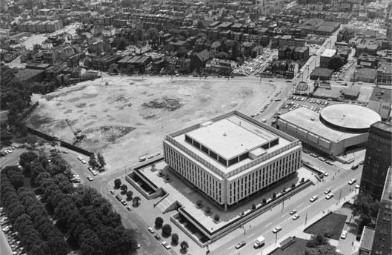
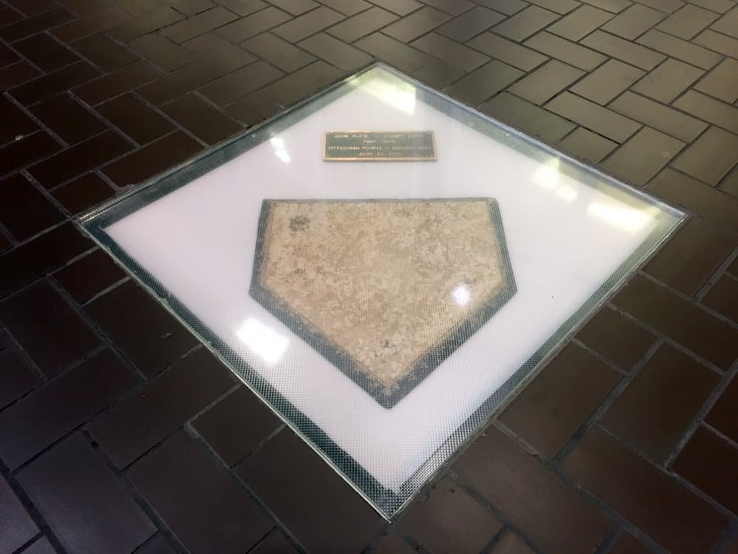
Our Team : Forbes Loaners
Confidentiality
Financial Flexibility
Lack of shared baseball resources
Affects prospects and free agency decisions

Slide 3
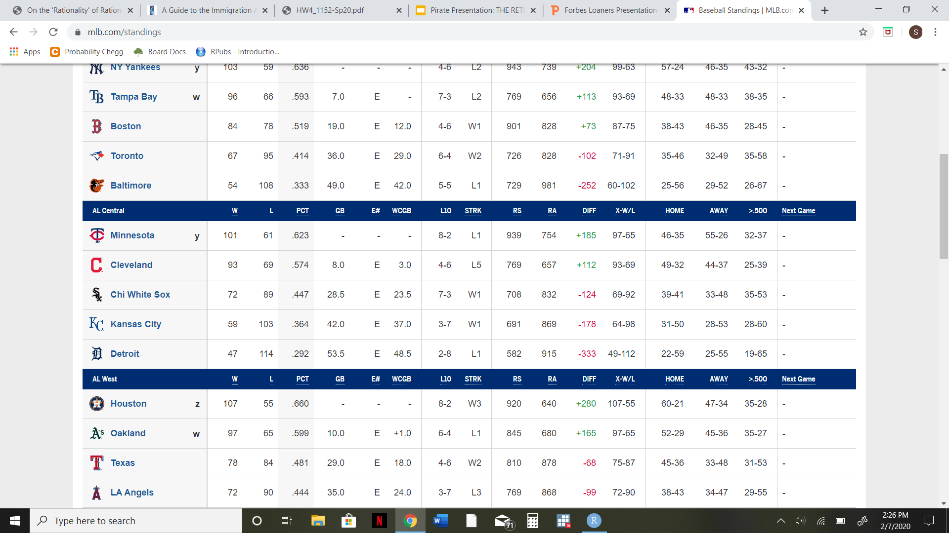


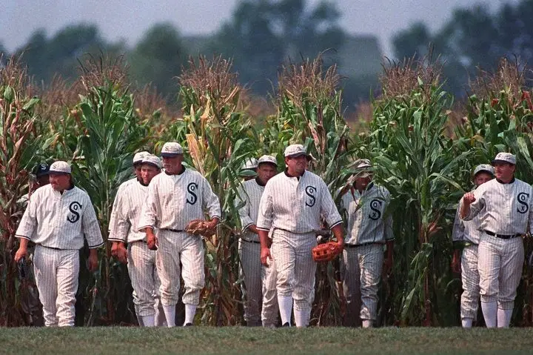
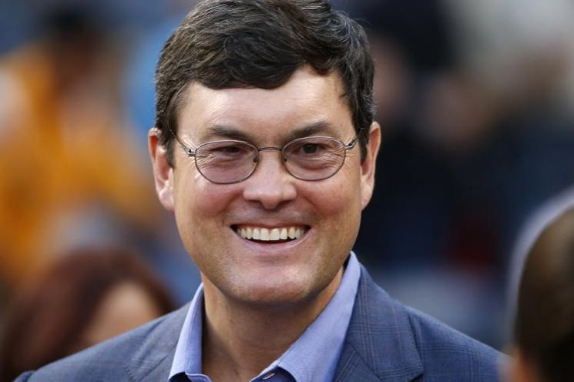
Current Standings in the IBL
IBL Misfits Division
Bad News Bears
Springfield Isotopes
Field of Dreams
Ghosts
Forbes Loaners
Financial Flexibility

Slide 4
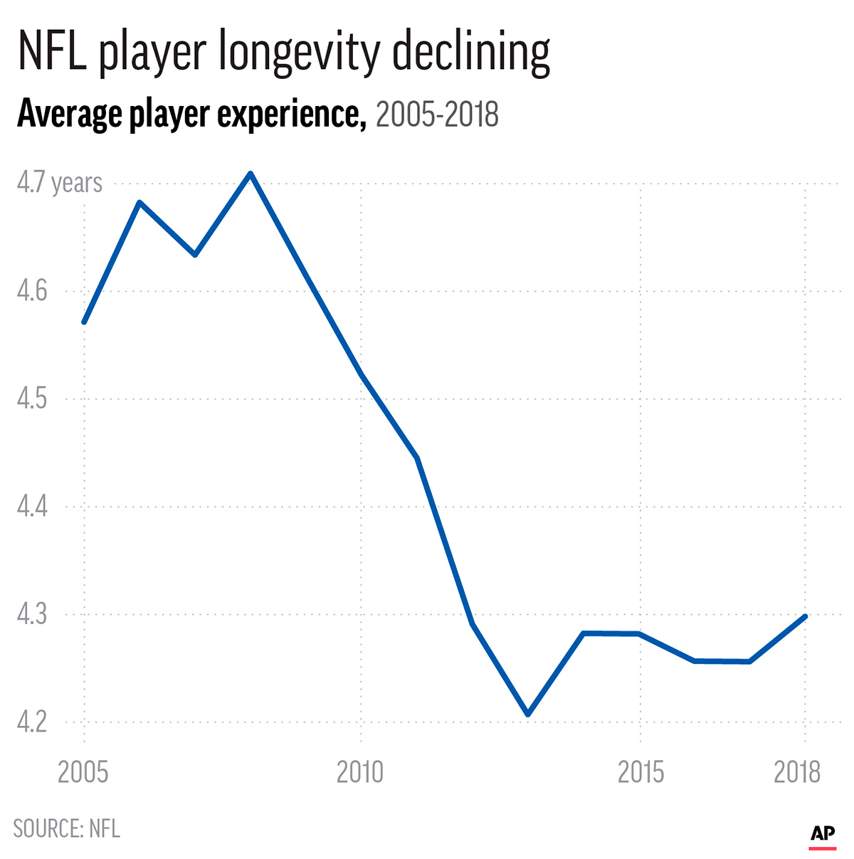
Problems
Question 1:
Can we predict a player’s ability to play at a particular position?
Can we predict when a player needs to switch to an easier position?
Question 2:
Can we establish our own database of recorded injuries and analyze trends among the data?
Best comparison – NFL analysis
Notes:
Create a predictive model that assesses the ability of a position player to play each defensive position given past performance and playing history.
Scrape known sources of injury data and establish a data engineering pipeline to maintain an injury database. In addition, the team could provide an interactive dashboard to viewing injury data summaries and trends or build a model to predict future injuries.
NFL -

Slide 5

What we’re trying
To figure out what variables are needed for the functions
How we should break up positions into x and y
Gather injury data; not easy to obtain
Challenges
No data provided explicitly - need to use public sources or scrape for data
Difficult to determine what is relevant
Web-scraping privileges at risk!

Slide 6
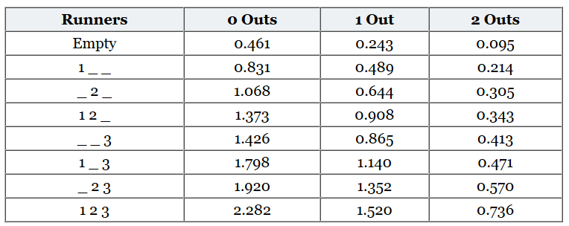

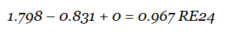
Possible Solution
Create run expectancy matrix, but runs prevented instead
Determine probability of position shift
Notes:
Example: play starts with runner on first base, zero outs; then batter hits a single where the batter gets to third base (no runs were scored)

Slide 7
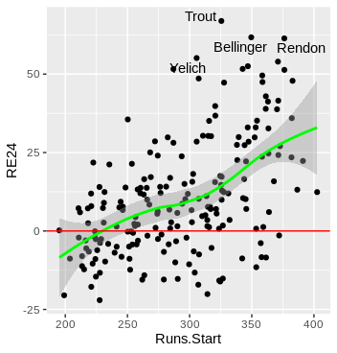
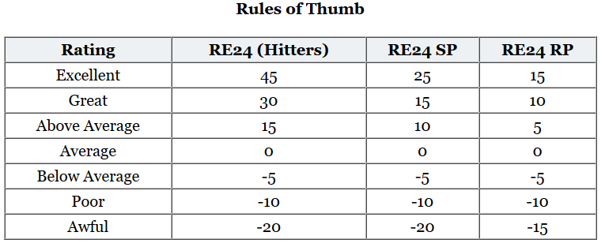
Possible Solution
Runs.start is the sum of each players’ starting state
Higher value = later in the lineup
Correlation between higher runs.start and higher RE24

Slide 8


Injury Problem Solution
In order to begin addressing our problem, we’ll first need to scrape data.
How do we turn this...
into this?

Slide 9
Injury Problem Solution: Gathering Data
<div jsmodel="vWNDde" jsdata="MuIEvd;;B91MGk">
<div jscontroller="TbaHGc" jsaction="rcuQ6b">...</div>
<div style="background:url(/images/sea…>..</div>
...
</div>
HTML
<div class="news-update is-injured has no player name">
<div class="news-update_top">...</div>
<main class="page pad-0-0">...</main>
</div>
<nav class="side-nav">
...

Slide 10
Injury Problem Solution: Gathering Data
How do get the relevant information out of this mess?
<div jsmodel="vWNDde" jsdata="MuIEvd;;B91MGk">
<div jscontroller="TbaHGc" jsaction="rcuQ6b">...</div>
<div style="background:url(/images/sea…>..</div>
...
</div>
HTML
<div class="news-update is-injured has no player name">
<div class="news-update_top">...</div>
<main class="page pad-0-0">...</main>
</div>
<nav class="side-nav">
...

Slide 11
Injury Problem Solution: Gathering Data
How do get the relevant information out of this mess?
<div jsmodel="vWNDde" jsdata="MuIEvd;;B91MGk">
<div jscontroller="TbaHGc" jsaction="rcuQ6b">...</div>
<div style="background:url(/images/sea…>..</div>
...
</div>
HTML
<div class="news-update is-injured has no player name">
<div class="news-update_top">...</div>
<main class="page pad-0-0">...</main>
Python:
BeautifulSoup
re
List Comprehensions
</div>
<nav class="side-nav">
...

Slide 12
Injury Problem Solution: Gathering Data
info = soup.find_all(‘div’, {‘class’: ‘news-update is injured has no player name’})
<div jsmodel="vWNDde" jsdata="MuIEvd;;B91MGk">
<div jscontroller="TbaHGc" jsaction="rcuQ6b">...</div>
<div style="background:url(/images/sea…>..</div>
...
</div>
HTML
<div class="news-update is-injured has no player name">
<div class="news-update_top">...</div>
<main class="page pad-0-0">...</main>
Python:
BeautifulSoup
re
List Comprehensions
</div>
<nav class="side-nav">
...

Slide 13
Injury Problem Solution: Gathering Data
info = soup.find_all(‘div’, {‘class’: ‘news-update is injured has no player name’})
<div jsmodel="vWNDde" jsdata="MuIEvd;;B91MGk">
<div jscontroller="TbaHGc" jsaction="rcuQ6b">...</div>
<div style="background:url(/images/sea…>..</div>
...
</div>
HTML
<div class="news-update is-injured has no player name">
<div class="news-update_top">...</div>
<main class="page pad-0-0">...</main>
</div>
<nav class="side-nav">
...

Slide 14
Injury Problem Solution: Gathering Data
info =
[
]
HTML
HTML
. . .
HTML
HTML
,
,
,
<div class="news-update is-injured has no player name">
<div class="news-update_top">...</div>
<div class="news-update_meta">...</div>
HTML
<div class="news-update_timestamp">...</div>
<div class="news-update_news">...</div>
</div>

Slide 15
Injury Problem Solution: Gathering Data
info =
[
]
HTML
HTML
. . .
HTML
HTML
,
,
,
qualifiers = re.compile(‘update_headline|update_inj|update_timestamp|update_news’)
[[soupy.getText() for soupy in tree.findChildren(‘div’, {‘class’: qualifiers})]
for tree in info]
<div class="news-update is-injured has no player name">
<div class="news-update_top">...</div>
<div class="news-update_meta">...</div>
HTML
<div class="news-update_timestamp">...</div>
<div class="news-update_news">...</div>
</div>

Slide 16
Injury Problem Solution: Gathering Data
info =
[
]
HTML
HTML
. . .
HTML
HTML
,
,
,
qualifiers = re.compile(‘update_headline|update_inj|update_timestamp|update_news’)
[[soupy.getText() for soupy in tree.findChildren(‘div’, {‘class’: qualifiers})]
for tree in info]
<div class="news-update is-injured has no player name">
<div class="news-update_top">...</div>
<div class="news-update_meta">...</div>
HTML
<div class="news-update_timestamp">...</div>
<div class="news-update_news">...</div>
</div>

Slide 17
Injury Problem Solution: Gathering Data
info =
[
[14626, Tommy John Surgery, 8/20/19, Avila is expected to undergo tommy j...],
[14626, Suffers Arm Injury, 8/16/19, Avila exited the game with what appe...],
…
[14626, Rehabbing in Rookie Ball, 8/5/2019, Avila covered 3.1 innings in r...],
[14626, Out With Elbow Strain, 4/23/2019, Avila will be shut down for at le...]
]
HTML

Slide 18
Injury Problem Solution: Gathering Data
info =
[
[14626, Tommy John Surgery, 8/20/19, Avila is expected to undergo tommy j...],
[14626, Suffers Arm Injury, 8/16/19, Avila exited the game with what appe...],
…
[14626, Rehabbing in Rookie Ball, 8/5/2019, Avila covered 3.1 innings in r...],
[14626, Out With Elbow Strain, 4/23/2019, Avila will be shut down for at le...]
]
[item for sublist in [injury_catcher(id) for ids in IDlist] if sublist is not None
for item in sublist if item is not None]
HTML
def injury_catcher(id):
all previous lines
rotowire_injury_report.csv

Slide 19
Injury Problem Solution: Relating Data
Current:
Planned:
rotowire_injury_report.csv
twitter_injury_report.csv
current_injury_list.csv
rotoworld_injury_list.csv
rotowire_players.csv
rotoworld_players.csv
mlbam_players.csv
website_random_walk.csv

Slide 20
Injury Problem Solution: Relating Data
Current:
Planned:
rotowire_injury_report.csv
twitter_injury_report.csv
current_injury_list.csv
rotoworld_injury_list.csv
rotowire_players.csv
rotoworld_players.csv
mlbam_players.csv
website_random_walk.csv
How do we structure and merge all this data together?

Slide 21
Injury Problem Solution: Relating Data (Example)
Current:
rotowire_players.csv
mlb_players.csv

Slide 22
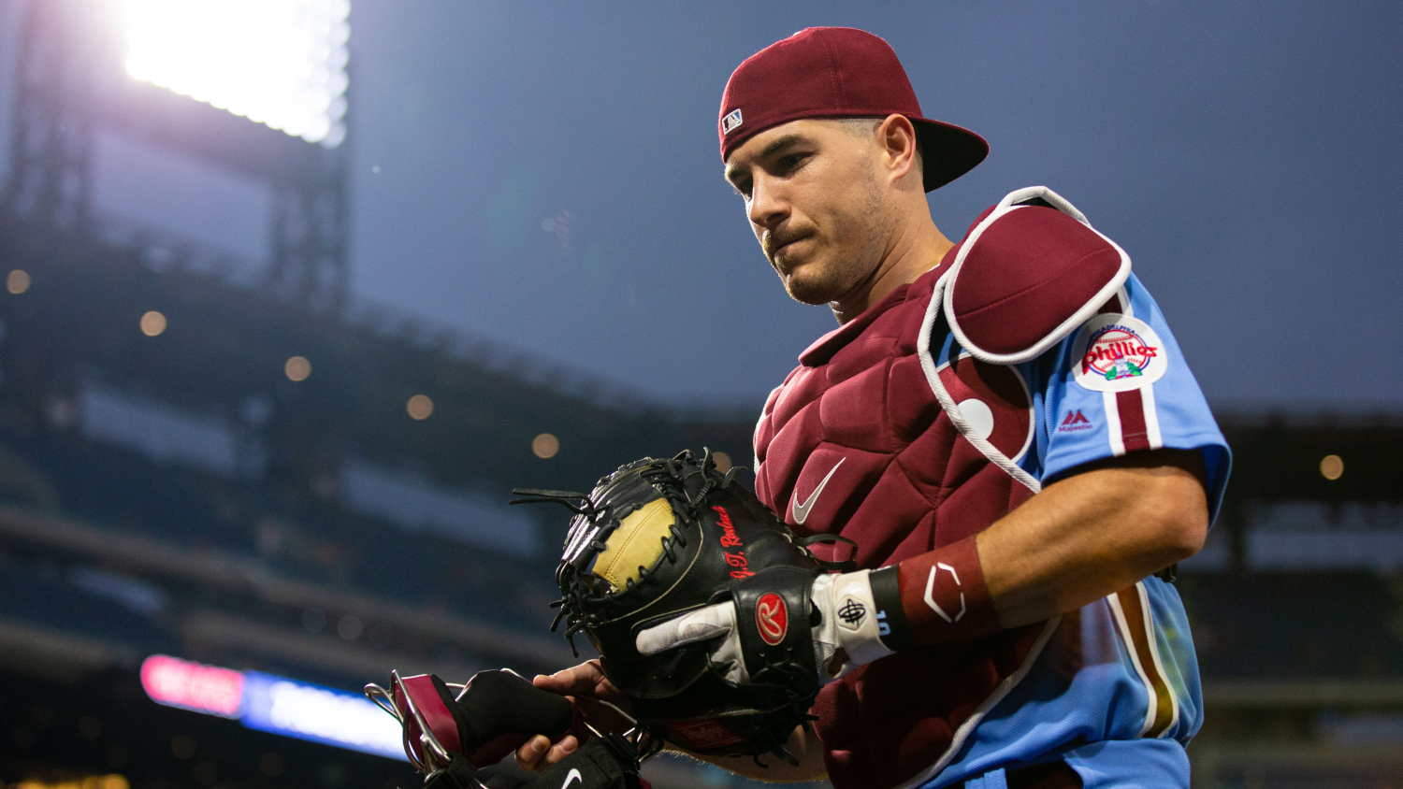
Injury Problem Solution: Relating Data (Example)
Current:
For J.T Realmuto:
rotowire_players.csv
mlb_players.csv
RotowireID: 592663
MLBID: 11641

Slide 23
Injury Problem Solution: Relating Data (Example)
Current:
For J.T Realmuto:
rotowire_players.csv
mlb_players.csv
RotowireID: 592663
MLBID: 11641
These two files have separate ID systems. How do we make it simple to work with both of them?

Slide 24

Injury Problem Solution: Relating Data (Example)
Current:
For J.T. Realmuto:
rotowire_players.csv
mlb_players.csv
RotowireID: 592663
MLBID: 11641
mlb <- read_csv(‘mlbam_players.csv’)
read_csv(‘rotowire_players.csv’) %>%
inner_join(mlb, by = c(‘fullName’, ‘DOB’)) %>%
distinct(fullName, MLBID, RotoID) %>%
write_csv(‘playerxref.csv’)

Slide 25
Injury Problem Solution: Relating Data (Example)
Current:
For J.T. Realmuto:
rotowire_players.csv
mlb_players.csv
RotowireID: 592663
MLBID: 11641
playerxref.csv

Slide 26


Injury Problem Solution: Current State
Current Setbacks:
Viable Solutions:
“Connection Reset by Peer” Error
Computer resources (time, speed)
Filtering/Cleaning of Data
Use remote Raspberry Pi in perpetuity
Use NLP, other ML techniques for effective filtering

Slide 27
Injury Problem Solution: Current State
Current Setbacks:
Viable Solutions:
“Connection Reset by Peer” Error
Computer resources (time, speed)
Filtering/Cleaning of Data
Use remote Raspberry Pi in perpetuity
Use NLP, other ML techniques for effective filtering
Next Targets:
Scraping of Rotoworld.com and merging information onto playerxref.csv
Look into efficacy of using Twitter as a source of injury data

Slide 28
Thank you! Any Questions?

